Slide 1


VOCABULARY BASICS
Use the tab key, space bar, arrow keys, or page up/down
to move through the slides.

Slide 2

VOCABULARY
BASICS
Second Edition
JUDITH NADELL
BETH JOHNSON
© 2011 Townsend Press

Slide 3

UNIT THREE
• advice • impossible
• cautious • necessary
• defeat • permit
• defect • provide
Notes:
Page 116 in textbook.

Slide 4

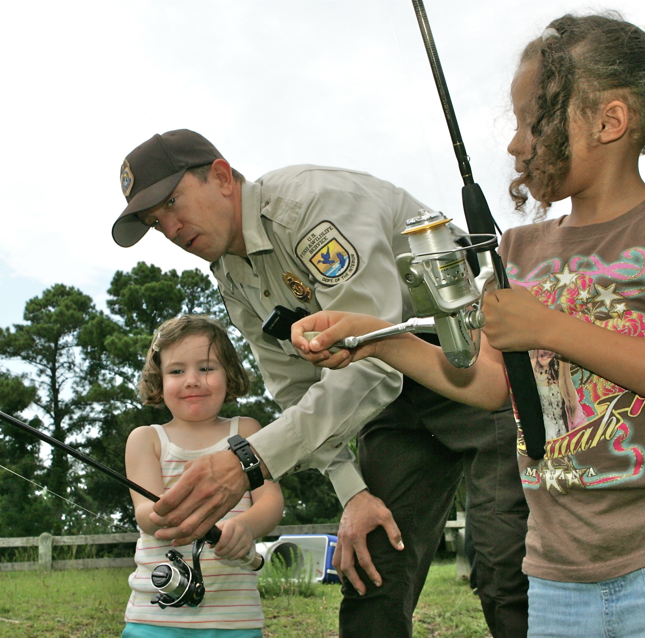
Learning Eight New Words
Choose the meaning closest to that of the boldfaced word.
1 advice
(ad-viis)
– noun
• My mother’s advice to me whenever I get sick is to stay in bed.
• Friends often give good advice when you are trying to make a decision.
Advice means
A. helpful idea.
B. friendship.
C. mistake.
Photo: US FWS/Steve Hillebrand
Giving a young girl advice about fishing
Notes:
Page 116 in textbook.
Answer: A
The next slide explains the answer.

Slide 5
Learning Eight New Words
Choose the meaning closest to that of the boldfaced word.
1 advice
(ad-viis)
– noun
• My mother’s advice to me whenever I get sick is to stay in bed.
• Friends often give good advice when you are trying to make a decision.
Advice means
A. helpful idea.
B. friendship.
C. mistake.
Photo: US FWS/Steve Hillebrand
Mother’s suggestion to stay in bed is a helpful idea. Friends can give helpful ideas when you need to make a decision.
Giving a young girl advice about fishing
Notes:
Page 116 in textbook.

Slide 6
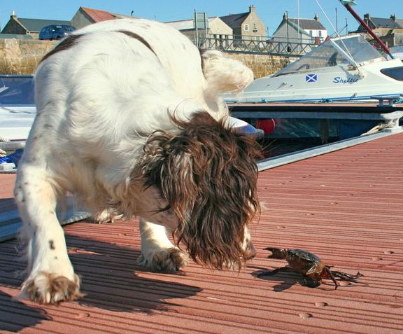
Learning Eight New Words
Choose the meaning closest to that of the boldfaced word.
2 cautious
(kaw-shuhss)
– adjective
• Ever since he stepped on a bee, Enrique has been cautious about walking in the grass with bare feet.
• You need to be cautious when riding a bike on busy roads.
Cautious means
A. happy.
B. tired.
C. careful.
Photo: Des Colhoun
A dog being cautious
as he inspects a crab
Notes:
Page 116 in textbook.
Answer: C
The next slide explains the answer.

Slide 7
Learning Eight New Words
Choose the meaning closest to that of the boldfaced word.
2 cautious
(kaw-shuhss)
– adjective
• Ever since he stepped on a bee, Enrique has been cautious about walking in the grass with bare feet.
• You need to be cautious when riding a bike on busy roads.
Cautious means
A. happy.
B. tired.
C. careful.
Photo: Des Colhoun
Stepping on a bee would make a person careful about walking in grass with bare feet. Riding a bike on busy roads is dangerous, so one must be careful.
A dog being cautious
as he inspects a crab
Notes:
Page 116 in textbook.

Slide 8
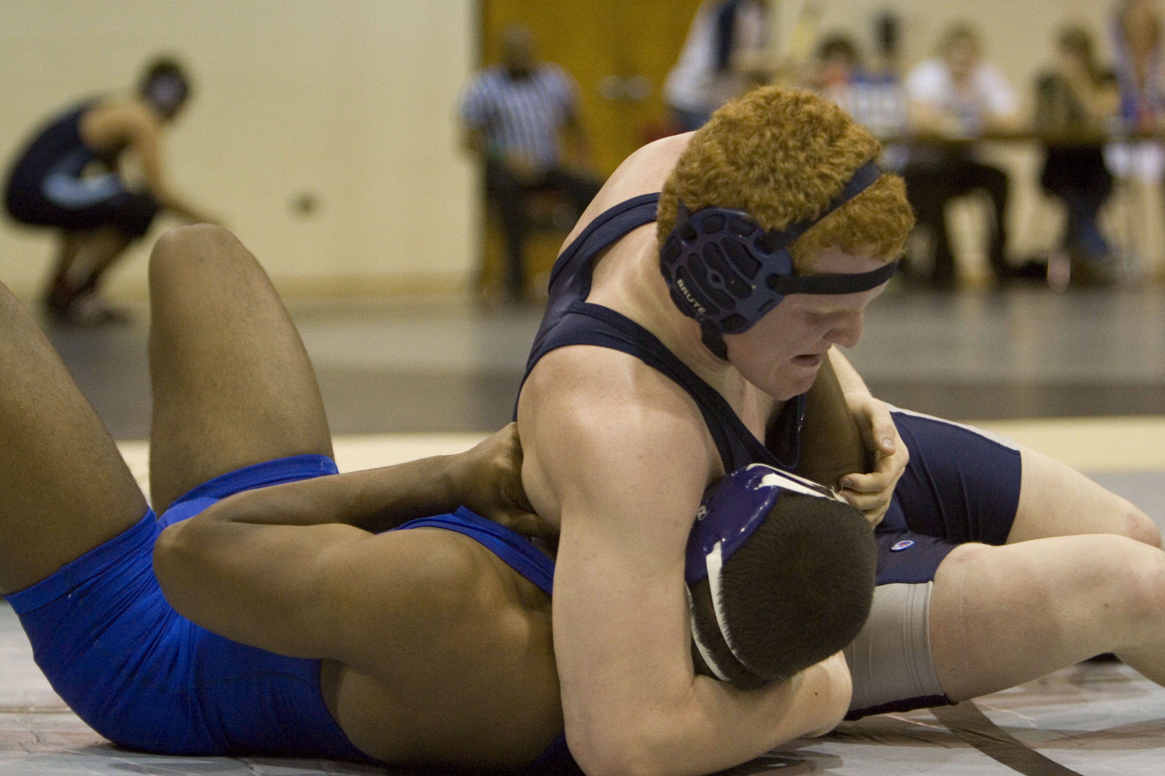
Learning Eight New Words
Choose the meaning closest to that of the boldfaced word.
3 defeat
(di-feet)
– verb
• If you can defeat your fears, you can do anything.
• Our soccer team played so well that we defeated the first-place team.
Defeat means
A. beat.
B. keep.
C. hide.
Photo: Dreier Carr
A wrestler defeating his opponent
Notes:
Page 116 in textbook.
Answer: A
The next slide explains the answer.

Slide 9
Learning Eight New Words
Choose the meaning closest to that of the boldfaced word.
3 defeat
(di-feet)
– verb
• If you can defeat your fears, you can do anything.
• Our soccer team played so well that we defeated the first-place team.
Defeat means
A. beat.
B. keep.
C. hide.
Photo: Dreier Carr
You have to beat your fears so they don’t hold you back. If the soccer team played very well, they must have beaten the first-place team.
A wrestler defeating his opponent
Notes:
Page 116 in textbook.

Slide 10
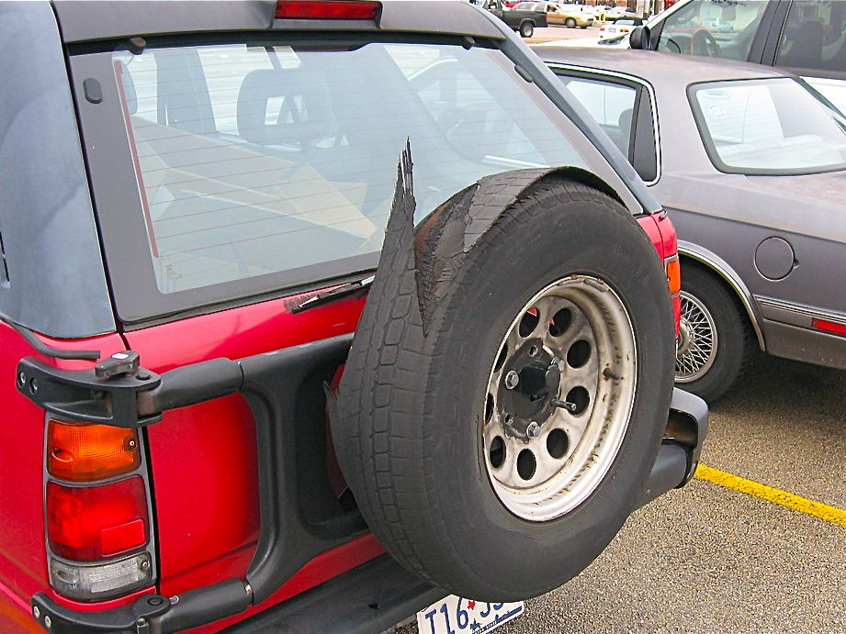
Learning Eight New Words
Choose the meaning closest to that of the boldfaced word.
4 defect
(dee-fekt)
– noun
• Martina returned her new jacket to the store because it had a defect—the zipper would not close.
• My boss finds defects in everyone else’s work, but he thinks his own work is perfect.
Defect means
A. cost.
B. problem.
C. best part.
Photo: Kurt Nordstrom
A tire with a defect
Notes:
Page 116 in textbook.
Answer: B
The next slide explains the answer.

Slide 11
Learning Eight New Words
Choose the meaning closest to that of the boldfaced word.
4 defect
(dee-fekt)
– noun
• Martina returned her new jacket to the store because it had a defect—the zipper would not close.
• My boss finds defects in everyone else’s work, but he thinks his own work is perfect.
Defect means
A. cost.
B. problem.
C. best part.
Photo: Kurt Nordstrom
A zipper that will not close is a problem. The word perfect tells you that the word defect means the opposite—“problem” or “fault.”
A tire with a defect
Notes:
Page 116 in textbook.

Slide 12
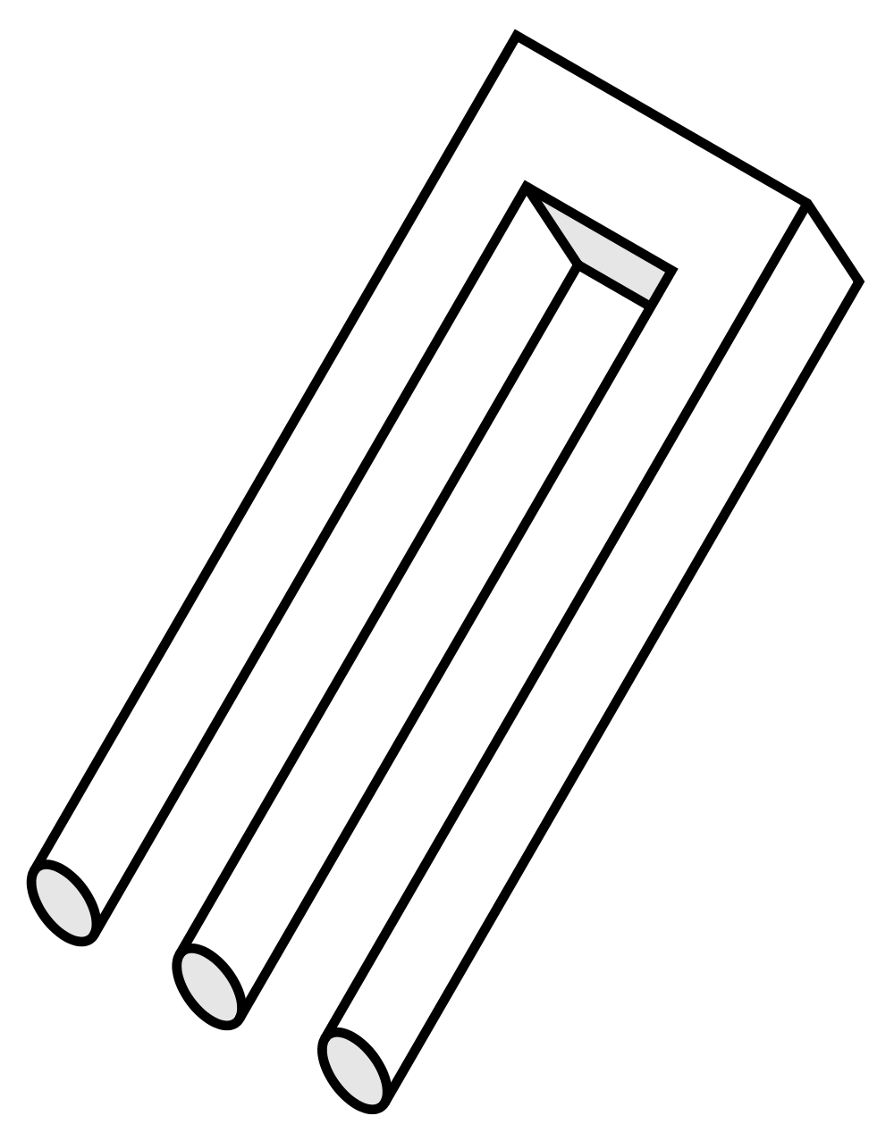
Learning Eight New Words
Choose the meaning closest to that of the boldfaced word.
5 impossible
(im-poss-uh-buhl)
– adjective
• Mira has to work on Saturday, so it is impossible for her to go on the camping trip this weekend.
• Until the 1960s, many people thought it would be impossible to travel to the moon.
Impossible means
A. usual.
B. not able to happen.
C. safe.
An impossible object
Notes:
Page 116 in textbook.
Answer: B
The next slide explains the answer.

Slide 13
Learning Eight New Words
Choose the meaning closest to that of the boldfaced word.
5 impossible
(im-poss-uh-buhl)
– adjective
• Mira has to work on Saturday, so it is impossible for her to go on the camping trip this weekend.
• Until the 1960s, many people thought it would be impossible to travel to the moon.
Impossible means
A. usual.
B. not able to happen.
C. safe.
If Mira has to work, she is not able to go on the trip. Many people used to think that we would not be able to travel to the moon.
An impossible object
Notes:
Page 116 in textbook.

Slide 14
Learning Eight New Words
Choose the meaning closest to that of the boldfaced word.
6 necessary
(ness-uh-ser-ee)
– adjective
• Before the bank can cash your check, it will be necessary for you to show your driver’s license.
• You will have to fill out the necessary forms before the doctor will see you.
Necessary means
A. not wanted.
B. careful.
C. needed.
Notes:
Page 117 in textbook.
Answer: C
The next slide explains the answer.

Slide 15
Learning Eight New Words
Choose the meaning closest to that of the boldfaced word.
6 necessary
(ness-uh-ser-ee)
– adjective
• Before the bank can cash your check, it will be necessary for you to show your driver’s license.
• You will have to fill out the necessary forms before the doctor will see you.
Necessary means
A. not wanted.
B. careful.
C. needed.
You need to show your driver’s license to cash your check at the bank. The forms are needed before the doctor will see you.
Notes:
Page 117 in textbook.

Slide 16
Learning Eight New Words
Choose the meaning closest to that of the boldfaced word.
7 permit
(pur-mit)
– verb
• Most stores don’t want customers to bring their pets inside, but they do permit people to bring in Seeing-Eye dogs.
• I don’t understand why Ralph permits his son to speak to him so rudely.
Permit means
A. understand.
B. let.
C. win.
Notes:
Page 117 in textbook.
Answer: B
The next slide explains the answer.

Slide 17
Learning Eight New Words
Choose the meaning closest to that of the boldfaced word.
7 permit
(pur-mit)
– verb
• Most stores don’t want customers to bring their pets inside, but they do permit people to bring in Seeing-Eye dogs.
• I don’t understand why Ralph permits his son to speak to him so rudely.
Permit means
A. understand.
B. let.
C. win.
Stores let customers come in with Seeing-Eye dogs. Ralph lets his son speak rudely to him.
Notes:
Page 117 in textbook.

Slide 18
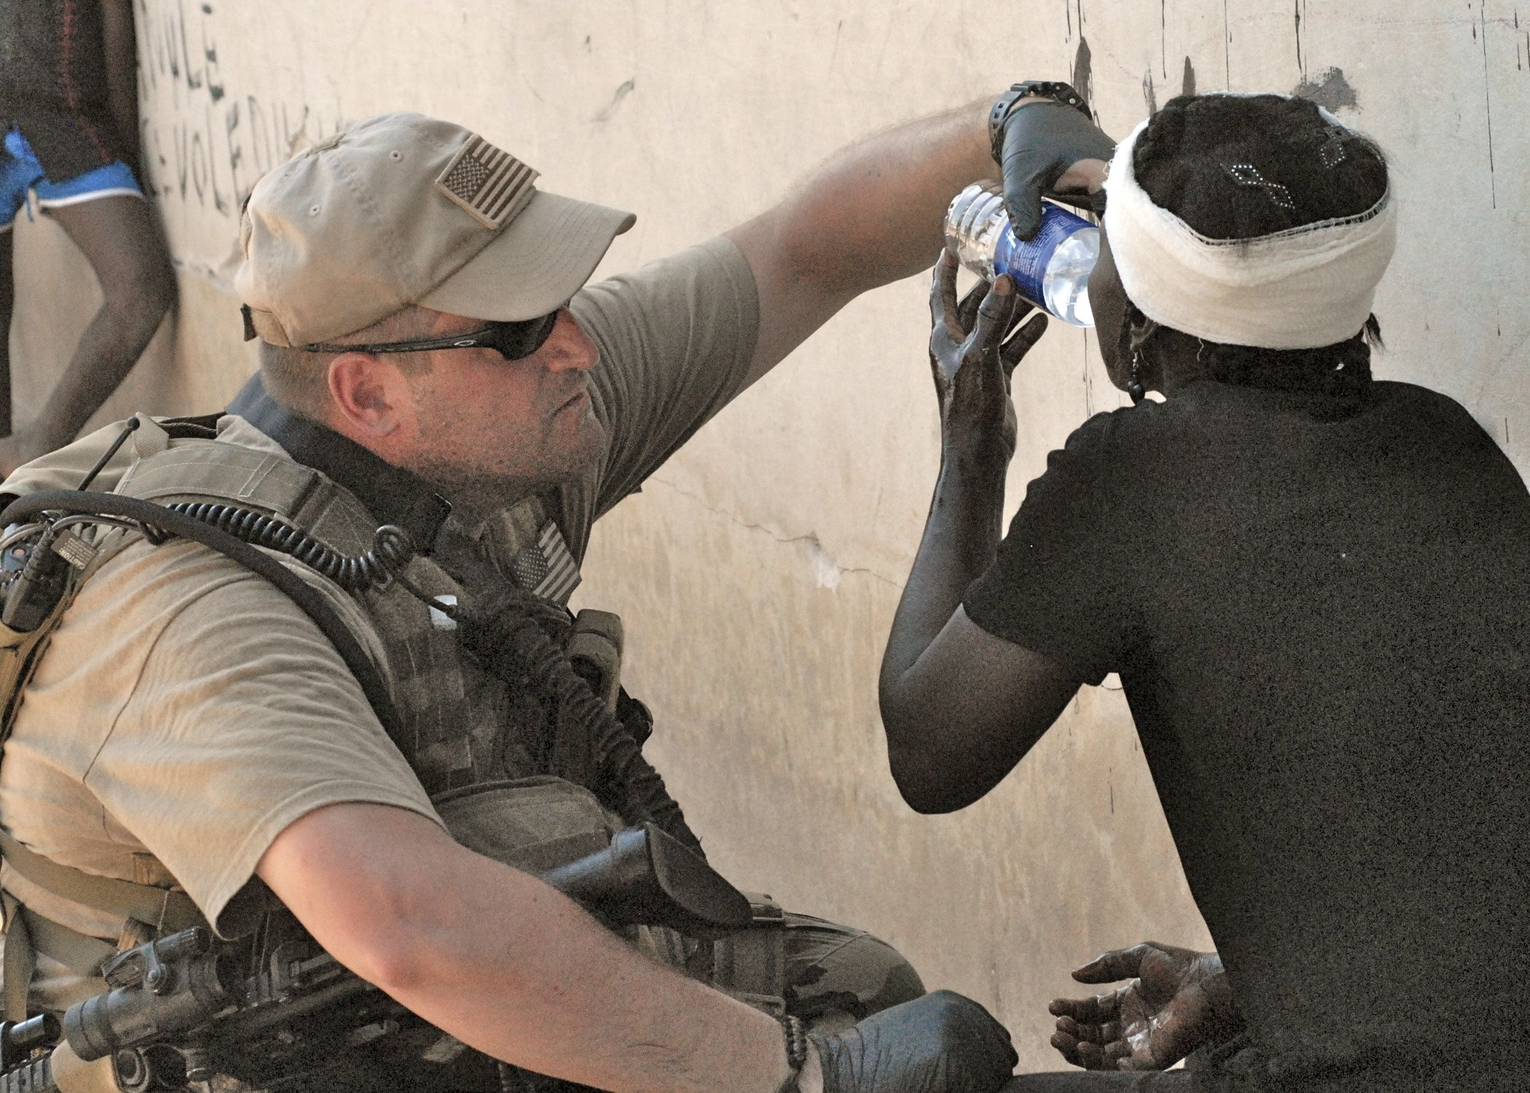
Learning Eight New Words
Choose the meaning closest to that of the boldfaced word.
8 provide
(pruh-viid)
– verb
• Two soup kitchens in the city provide free meals to hungry families.
• Before the test, the instructor provided a pencil to every student.
Provide means
A. give.
B. take away.
C. show.
Photo: US Navy
A sailor provides water to
a person hurt in an earthquake
Notes:
Page 117 in textbook.
Answer: A
The next slide explains the answer.

Slide 19
Learning Eight New Words
Choose the meaning closest to that of the boldfaced word.
8 provide
(pruh-viid)
– verb
• Two soup kitchens in the city provide free meals to hungry families.
• Before the test, the instructor provided a pencil to every student.
Provide means
A. give.
B. take away.
C. show.
Photo: US Navy
Soup kitchens are places that give free meals to hungry families. The instructor would give every student a pencil before the test.
A sailor provides water to
a person hurt in an earthquake
Notes:
Page 117 in textbook.

Slide 20
Adding One Word to an Item
Complete each item with the correct word from the box.
A. advice B. cautious
C. defeated
D. defects
E. impossible F. necessary
G. permits
H. provide
1. The store sells “not quite perfect” clothes that have small . . ? . . you can barely see.
2. When we saw lightning in the sky, we decided to be . . ? . . and go indoors.
Notes:
Page 118 in textbook.
Answers: 1. defects; 2. cautious
The next slide explains the answers.

Slide 21
Adding One Word to an Item
Complete each item with the correct word from the box.
A. advice B. cautious
C. defeated
D. defects
E. impossible F. necessary
G. permits
H. provide
1. The store sells “not quite perfect” clothes that have small defects you can barely see.
Clothes that are “not quite perfect” would have small problems or faults.
2. When we saw lightning in the sky, we decided to be cautious and go indoors.
Going indoors when there is lightning is being careful.
Notes:
Page 118 in textbook.

Slide 22
Adding One Word to an Item
Complete each item with the correct word from the box.
A. advice B. cautious
C. defeated
D. defects
E. impossible F. necessary
G. permits
H. provide
3. The basketball star’s . . ? . . to students was simple: “Stay in school, work hard, and stay off drugs!”
4. To make these cookies, chocolate chips, oatmeal, and walnuts are . . ? . . .
Notes:
Page 118 in textbook.
Answers: 3. advice; 4. necessary
The next slide explains the answers.

Slide 23
Adding One Word to an Item
Complete each item with the correct word from the box.
A. advice B. cautious
C. defeated
D. defects
E. impossible F. necessary
G. permits
H. provide
3. The basketball star’s advice to students was simple: “Stay in school, work hard, and stay off drugs!”
“Stay in school, work hard, and stay off drugs” are helpful ideas.
4. To make these cookies, chocolate chips, oatmeal, and walnuts are necessary.
Chocolate chips, oatmeal, and walnuts are needed to make the cookies.
Notes:
Page 118 in textbook.

Slide 24
Adding One Word to an Item
Complete each item with the correct word from the box.
A. advice B. cautious
C. defeated
D. defects
E. impossible F. necessary
G. permits
H. provide
5. I know who is bringing hot dogs to the picnic, but who will . . ? . . the soda?
6. If you water plants only once in a while, it will be . . ? . . for them to grow healthy and strong.
Notes:
Page 118 in textbook.
Answers: 5. provide; 6. impossible
The next slide explains the answers.

Slide 25
Adding One Word to an Item
Complete each item with the correct word from the box.
A. advice B. cautious
C. defeated
D. defects
E. impossible F. necessary
G. permits
H. provide
5. I know who is bringing hot dogs to the picnic, but who will provide the soda?
The person does not know who will give (or bring) the soda.
6. If you water plants only once in a while, it will be impossible for them to grow healthy and strong.
It is not possible for plants to grow healthy and strong if they do not get enough water.
Notes:
Page 118 in textbook.

Slide 26
Adding One Word to an Item
Complete each item with the correct word from the box.
A. advice B. cautious
C. defeated
D. defects
E. impossible F. necessary
G. permits
H. provide
7. We . . ? . . the ants in our kitchen with a broom and a can of bug spray.
8. That boss . . ? . . workers to wear jeans on Fridays.
Notes:
Page 118 in textbook.
Answers: 7. defeated; 8. permits
The next slide explains the answers.

Slide 27
Adding One Word to an Item
Complete each item with the correct word from the box.
A. advice B. cautious
C. defeated
D. defects
E. impossible F. necessary
G. permits
H. provide
7. We defeated the ants in our kitchen with a broom and a can of bug spray.
Bug spray is one way to beat ants.
8. That boss permits workers to wear jeans on Fridays.
The boss lets workers wear jeans.
Notes:
Page 118 in textbook.

