Slide 1


VOCABULARY BASICS
Use the tab key, space bar, arrow keys, or page up/down
to move through the slides.

Slide 2

VOCABULARY
BASICS
Second Edition
JUDITH NADELL
BETH JOHNSON
© 2011 Townsend Press

Slide 3

UNIT ONE
• daily • negative
• entertain • original
• experience • produce
• identify • tension
Notes:
Page 14 in textbook.

Slide 4


Learning Eight New Words
Choose the meaning closest to that of the boldfaced word.
1 daily
(day-lee)
– adjective
• Noah goes to the gym seven days a week. He says daily exercise keeps him healthy and happy.
• Washing the dishes is one of my sister’s daily jobs.
Daily means
A. happening each year.
B. happening each week.
C. happening each day.
The restaurant opens daily at 11 a.m.
Notes:
Page 14 in textbook.
Answer: C
The next slide explains the answer.

Slide 5
Learning Eight New Words
Choose the meaning closest to that of the boldfaced word.
1 daily
(day-lee)
– adjective
• Noah goes to the gym seven days a week. He says daily exercise keeps him healthy and happy.
• Washing the dishes is one of my sister’s daily jobs.
Daily means
A. happening each year.
B. happening each week.
C. happening each day.
The restaurant opens daily at 11 a.m.
If Noah goes to the gym seven days a week, he exercises each day. Washing the dishes is something the sister does each day.
Notes:
Page 14 in textbook.

Slide 6
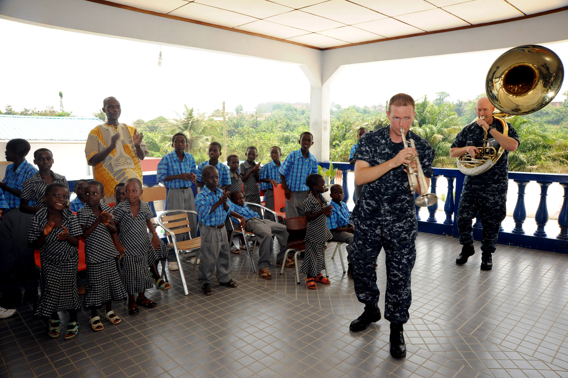
Learning Eight New Words
Choose the meaning closest to that of the boldfaced word.
2 entertain
(en-tur-tain)
– verb
• Cristine thought the novel would entertain her, but instead it put her to sleep.
• While we were stuck at home during the snowstorm, my brother entertained us with ghost stories.
Entertain means
A. change.
B. make sleepy.
C. interest greatly.
Photo: US Air Force/Russell J. McBride
Musicians entertaining children
Notes:
Page 14 in textbook.
Answer: C
The next slide explains the answer.

Slide 7
Learning Eight New Words
Choose the meaning closest to that of the boldfaced word.
2 entertain
(en-tur-tain)
– verb
• Cristine thought the novel would entertain her, but instead it put her to sleep.
• While we were stuck at home during the snowstorm, my brother entertained us with ghost stories.
Entertain means
A. change.
B. make sleepy.
C. interest greatly.
If the novel put Cristine to sleep, it did not interest her greatly. Telling ghost stories is a way to interest someone greatly.
Photo: US Air Force/Russell J. McBride
Musicians entertaining children
Notes:
Page 14 in textbook.

Slide 8
Learning Eight New Words
Choose the meaning closest to that of the boldfaced word.
3 experience
(ek-spihr-ee-uhnss)
– noun
• Having his car break down on a busy highway was one experience Lamar did not want to have again.
• I’m happy to say that working at the day care center turned out to be a wonderful experience.
Experience means
A. difficult question.
B. something a person lives through.
C. good reason.
Notes:
Page 14 in textbook.
Answer: B
The next slide explains the answer.

Slide 9
Learning Eight New Words
Choose the meaning closest to that of the boldfaced word.
3 experience
(ek-spihr-ee-uhnss)
– noun
• Having his car break down on a busy highway was one experience Lamar did not want to have again.
• I’m happy to say that working at the day care center turned out to be a wonderful experience.
Experience means
A. difficult question.
B. something a person lives through.
C. good reason.
Having one’s car break down is something a person lives through. Working at the day care center was something wonderful that the person lived through.
Notes:
Page 14 in textbook.

Slide 10
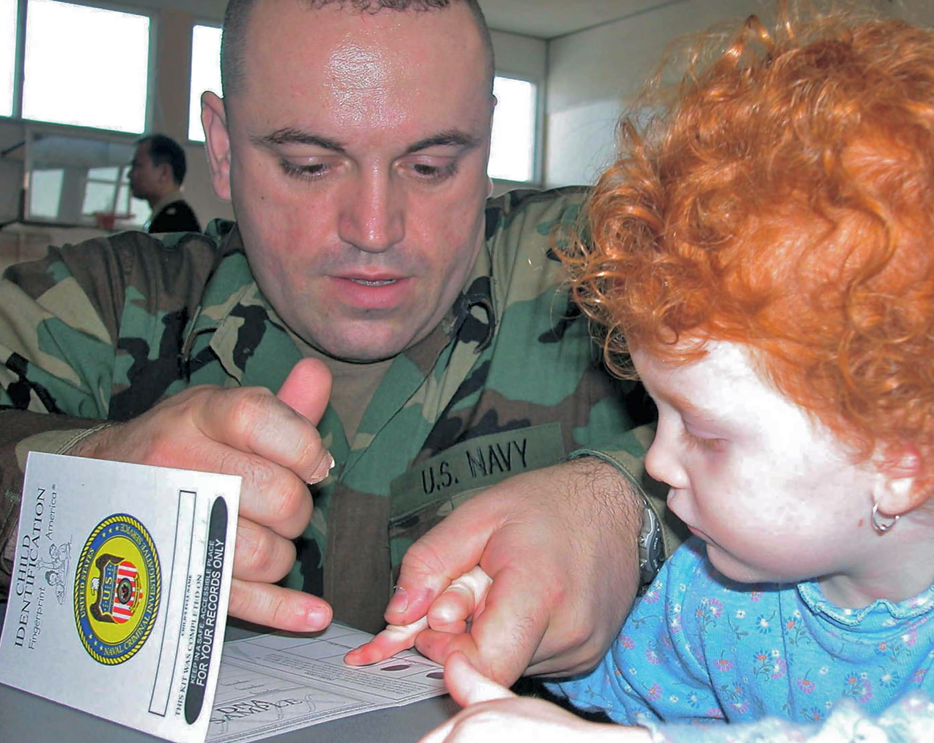
Learning Eight New Words
Choose the meaning closest to that of the boldfaced word.
4 identify
(ii-den-tuh-fii)
– verb
• Blind people can identify coins by their size and whether or not they have smooth edges.
• The police used the fingerprints they found to identify who the bank robbers were.
Identify means
A. dislike.
B. make.
C. find out.
Photo: US Navy/Bruce Cummins
Recording fingerprints so the child can
be identified if she goes missing.
Notes:
Page 14 in textbook.
Answer: C
The next slide explains the answer.

Slide 11
Learning Eight New Words
Choose the meaning closest to that of the boldfaced word.
4 identify
(ii-den-tuh-fii)
– verb
• Blind people can identify coins by their size and whether or not they have smooth edges.
• The police used the fingerprints they found to identify who the bank robbers were.
Identify means
A. dislike.
B. make.
C. find out.
One way to find out what coin one is holding is by feeling its size and its edges. Using fingerprints is one way that the police find out who carried out a crime.
Photo: US Navy/Bruce Cummins
Recording fingerprints so the child can
be identified if she goes missing.
Notes:
Page 14 in textbook.

Slide 12
Learning Eight New Words
Choose the meaning closest to that of the boldfaced word.
5 negative
(neg-uh-tiv)
– adjective
• People who feel negative about themselves often have trouble making friends.
• I turned off the TV because I didn’t want to see another negative story about crime and violence.
Negative means
A. nice.
B. bad.
C. interesting.
Notes:
Page 14 in textbook.
Answer: B
The next slide explains the answer.

Slide 13
Learning Eight New Words
Choose the meaning closest to that of the boldfaced word.
5 negative
(neg-uh-tiv)
– adjective
• People who feel negative about themselves often have trouble making friends.
• I turned off the TV because I didn’t want to see another negative story about crime and violence.
Negative means
A. nice.
B. bad.
C. interesting.
It is easier for a person who feels good about himself or herself to make friends than it is for a person who feels bad or not positive. The person finds TV stories about crime and violence bad or not positive.
Notes:
Page 14 in textbook.

Slide 14
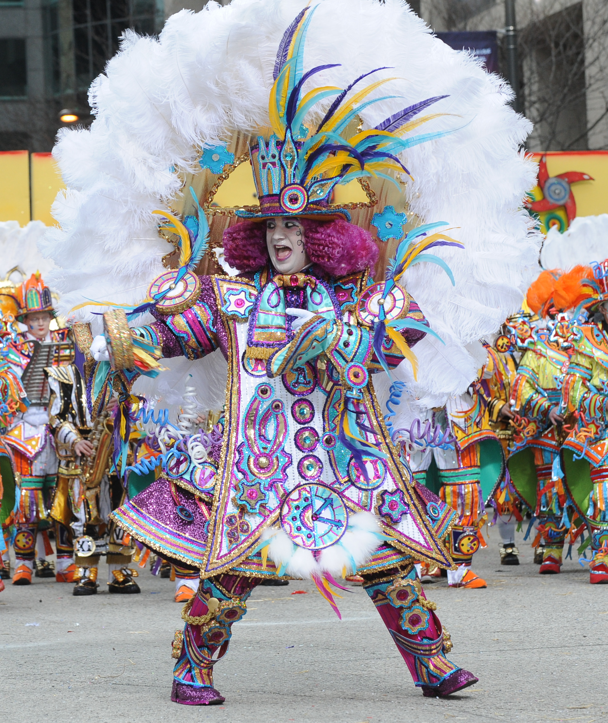
Learning Eight New Words
Choose the meaning closest to that of the boldfaced word.
6 original
(uh-rij-uh-nuhl)
– adjective
• My ideas for the surprise party were boring and unexciting, but Carla’s were interesting and original.
• All the students in the class thought that the ending of my short story was original and very different from anything they had ever read.
Original means
A. quiet.
B. weak.
C. fresh.
A man in an original costume
Photo: Roniannacone
Notes:
Page 15 in textbook.
Answer: C
The next slide explains the answer.

Slide 15
Learning Eight New Words
Choose the meaning closest to that of the boldfaced word.
6 original
(uh-rij-uh-nuhl)
– adjective
• My ideas for the surprise party were boring and unexciting, but Carla’s were interesting and original.
• All the students in the class thought that the ending of my short story was original and very different from anything they had ever read.
Original means
A. quiet.
B. weak.
C. fresh.
A man in an original costume
Carla’s ideas are the opposite of boring and unexciting. They are interesting and fresh. An ending that is very different from anything they had ever read would be fresh or not like anything else.
Photo: Roniannacone
Notes:
Page 15 in textbook.

Slide 16
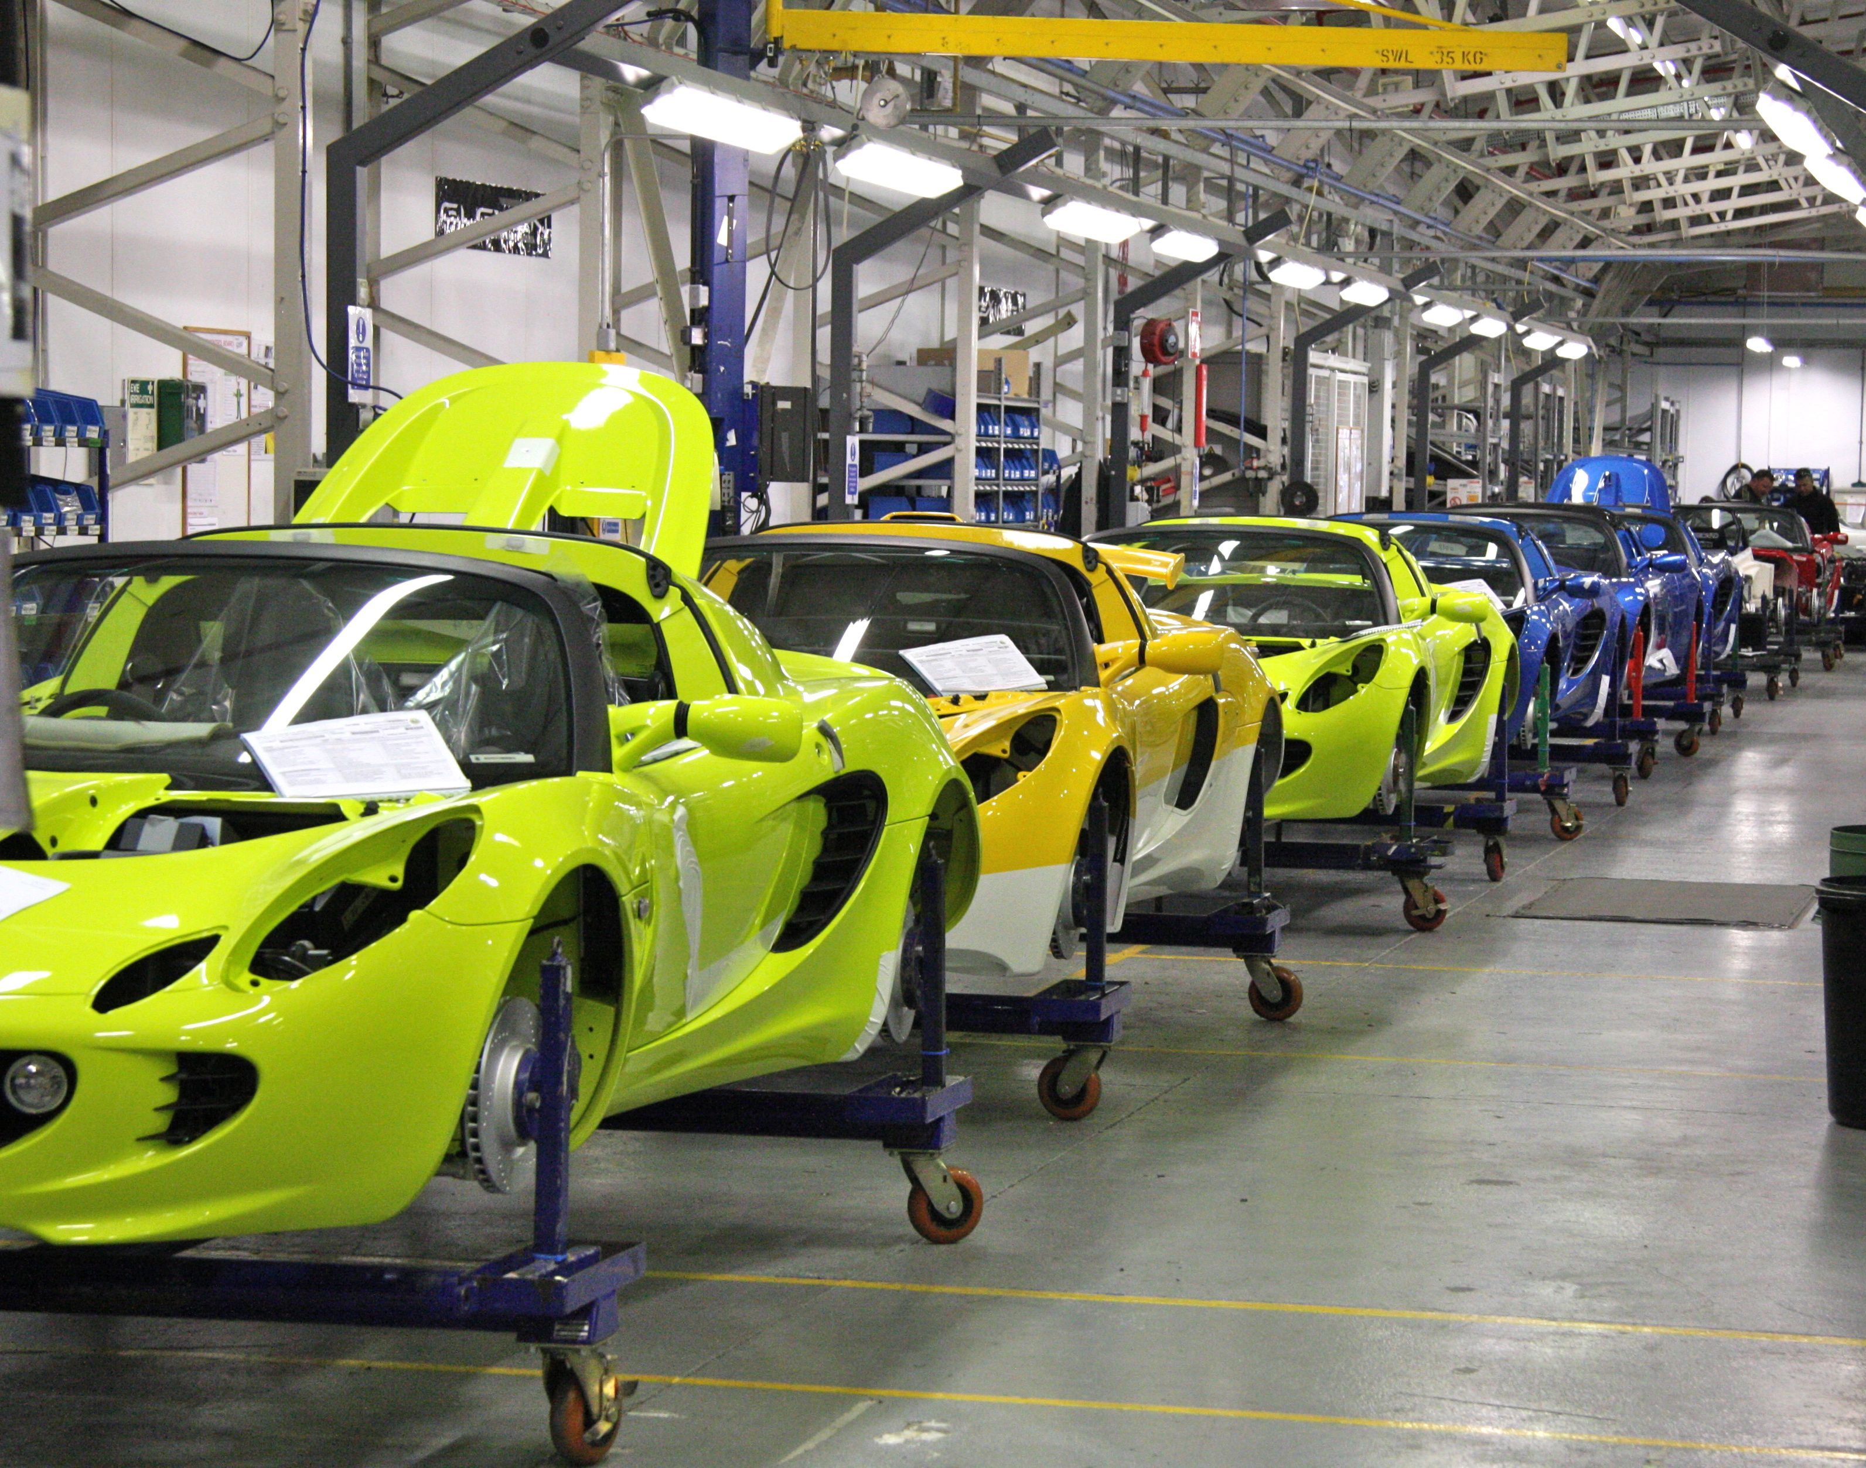
Learning Eight New Words
Choose the meaning closest to that of the boldfaced word.
7 produce
(pruh-dooss)
– verb
• The new factory in town can produce millions of bottles a year.
• My little nephew produces the loudest snores I have ever heard.
Produce means
A. make.
B. break.
C. take.
Photo: Brian Snelson
Cars being produced in a factory
Notes:
Page 15 in textbook.
Answer: A
The next slide explains the answer.

Slide 17
Learning Eight New Words
Choose the meaning closest to that of the boldfaced word.
7 produce
(pruh-dooss)
– verb
• The new factory in town can produce millions of bottles a year.
• My little nephew produces the loudest snores I have ever heard.
Produce means
A. make.
B. break.
C. take.
The factory makes bottles. The nephew makes or brings about loud snores.
Photo: Brian Snelson
Cars being produced in a factory
Notes:
Page 15 in textbook.

Slide 18
Learning Eight New Words
Choose the meaning closest to that of the boldfaced word.
8 tension
(ten-shuhn)
– noun
• Whenever she gets upset or feels tension, Jane takes a hot bath.
• When I feel tension, I relax by going for a long, quiet walk.
Tension means
A. rest.
B. happiness.
C. worry.
Notes:
Page 15 in textbook.
Answer: C
The next slide explains the answer.

Slide 19
Learning Eight New Words
Choose the meaning closest to that of the boldfaced word.
8 tension
(ten-shuhn)
– noun
• Whenever she gets upset or feels tension, Jane takes a hot bath.
• When I feel tension, I relax by going for a long, quiet walk.
Tension means
A. rest.
B. happiness.
C. worry.
A hot bath is a way to calm down and get rid of worry. A long, quiet walk is another way to relax and get rid of worry.
Notes:
Page 15 in textbook.

Slide 20
Adding One Word to an Item
Complete each item with the correct word from the box.
A. daily B. entertained
C. experience
D. identify
E. negative F. original
G. produced
H. tension
1. Many students feel . . ? . . before they take a test.
2. After months of cutting and sewing, the group
. . ? . . a beautiful quilt.
Notes:
Page 16 in textbook.
Answers: 1. tension; 2. produced
The next slide explains the answers.

Slide 21
Adding One Word to an Item
Complete each item with the correct word from the box.
A. daily B. entertained
C. experience
D. identify
E. negative F. original
G. produced
H. tension
1. Many students feel tension before they take a test.
Students often have a nervous feeling before taking a test
2. After months of cutting and sewing, the group produced a beautiful quilt.
Cutting and sewing is the way a group makes a quilt
Notes:
Page 16 in textbook.

Slide 22
Adding One Word to an Item
Complete each item with the correct word from the box.
A. daily B. entertained
C. experience
D. identify
E. negative F. original
G. produced
H. tension
3. My neighbor, Mrs. Yoo, likes to read the . . ? . . newspaper on her porch.
4. My father’s high-school graduation was an . . ? . . we will never forget.
Notes:
Page 16 in textbook.
Answers: 3. daily; 4. experience
The next slide explains the answers.

Slide 23
Adding One Word to an Item
Complete each item with the correct word from the box.
A. daily B. entertained
C. experience
D. identify
E. negative F. original
G. produced
H. tension
3. My neighbor, Mrs. Yoo, likes to read the daily newspaper on her porch.
Many people have a newspaper delivered every day.
4. My father’s high-school graduation was an experience we will never forget.
Seeing one’s father graduate from high school is something a son or daughter would live through and not forget.
Notes:
Page 16 in textbook.

Slide 24
Adding One Word to an Item
Complete each item with the correct word from the box.
A. daily B. entertained
C. experience
D. identify
E. negative F. original
G. produced
H. tension
5. Kendra was happy when her boss told her that she had some helpful and . . ? . . ideas for improving business.
6. My blind date said I could . . ? . . him at the coffee shop by his red hair and beard.
Notes:
Page 16 in textbook.
Answers: 5. original; 6. identify
The next slide explains the answers.

Slide 25
Adding One Word to an Item
Complete each item with the correct word from the box.
A. daily B. entertained
C. experience
D. identify
E. negative F. original
G. produced
H. tension
5. Kendra was happy when her boss told her that she had some helpful and original ideas for improving business.
Helpful ideas for improving business would be new or fresh ideas.
6. My blind date said I could identify him at the coffee shop by his red hair and beard.
The blind date’s red hair and beard are ways to find out exactly who he is.
Notes:
Page 16 in textbook.

Slide 26
Adding One Word to an Item
Complete each item with the correct word from the box.
A. daily B. entertained
C. experience
D. identify
E. negative F. original
G. produced
H. tension
7. Gina doesn’t seem to like her relatives. She’s always saying . . ? . . things about them.
8. My three-year-old nephew . . ? . . us by singing a little song about a spider in the rain.
Notes:
Page 16 in textbook.
Answers: 7. negative; 8. entertained
The next slide explains the answers.

Slide 27
Adding One Word to an Item
Complete each item with the correct word from the box.
A. daily B. entertained
C. experience
D. identify
E. negative F. original
G. produced
H. tension
7. Gina doesn’t seem to like her relatives. She’s always saying negative things about them.
If Gina doesn’t like her relatives, she would say bad things about them.
8. My three-year-old nephew entertained us by singing a little song about a spider in the rain.
Singing a little song is a way to keep people’s interest with something happy or enjoyable.
Notes:
Page 16 in textbook.

